Slide 1
HUMAN COMPUTER INTERACTION
LECTURE 5,6

Slide 2
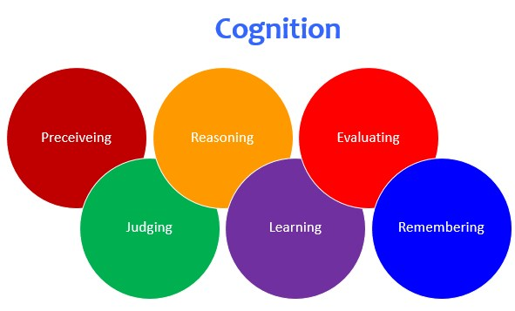
Cognition:
Cognition is the mental action or process of acquiring knowledge and understanding through thought, experience and the senses.
There are many different kinds of cognition such as thinking , remembering, learning, daydreaming, decision making, seeing, reading, writing and talking.

Slide 3


There are two general modes of cognition : Experimental and Reflective cognition.
Experiential Cognition is a state of mind in which we perceive , act and react to events around us effectively and effortlessly.
It requires reaching a certain level of expertise and engagement.
Examples include driving a car , reading a book, having a conversation, and playing a video game.

Slide 4


Reflective cognition involves thinking, comparing, and decision making. This kind of cognition is what leads to new ideas and creativity.
Examples include designing ,learning and writing a book .

Slide 5
Both modes of cognition are essential for everyday life but each requires different kinds of technological support. The study of human cognition can help understand human abilities and limitations when interacting with technologies.
HCI focusses on examining cognitive aspects of interaction design.
We analyze about what humans are good and bad at and show how this knowledge can be used to inform the design of technologies that both extend human capabilities and compensate for their weakness.
The study of cognitive based conceptual frameworks helps in explaining the way humans interact with computers.

Slide 6
Cognitive Frameworks:
A number of conceptual frameworks and theories have been developed to explain and predict user behavior based on theories of cognition.
There are three early internal frameworks that focus primarily on mental process and three external frameworks that explain how humans interact and use technologies.
Internal frameworks : Mental models
Gulfs of execution and evaluation
Information processing
External frameworks : Distributed cognition
External cognition
Embodied interaction

Slide 7
Internal Frameworks
Mental models: People primarily develop knowledge of how to interact with systems and to a lesser extent how that system works. The two kinds of knowledge were often referred to as users mental model.
It is assumed that mental models are used by people to reason about a system and try to find out what to do when something unexpected happens. The more someone learn about a system and how it functions the more their mental model develops.
Within cognitive psychology , mental models have been projected as internal constructions of some aspect of external world that are manipulated , enabling predictions and inferences to be made.
This can involve both unconscious and conscious mental process where images and analogies are activated.

Slide 8
If people could develop better mental models of interactive systems they would be in a better position to know how to carry out their tasks efficiently and know what to do if a system started malfunctioning.
If Interactive technologies could be designed to be more transparent, then it might be easier to understand them in terms of how they work and what to do when they don’t.
Transparency involves
-Useful feedback in response to user input.
-Easy to understand and easy ways of interacting.
It also requires providing the right kind and level of information in the form of
-clear and easy to follow instructions.
-appropriate online help and tutorials.
-context sensitive guidance for users, at their level of experience.

Slide 9
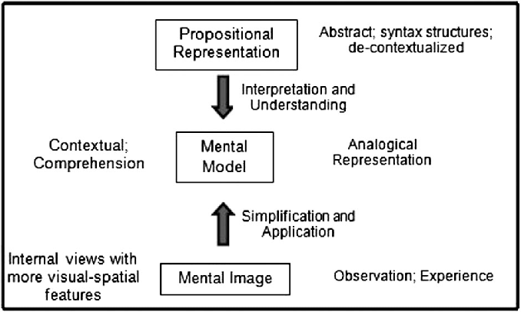

Slide 10
Gulfs of execution and evaluation:
The gulf of execution and the gulf of evaluation describe the gaps that exist between the user and the interface. They are intended to show how to design to enable the user to cope with them.
The first one-The gulf of execution describes the distance from the user to the physical system, while the second one-the gulf of evaluation is the distance from physical system to the user.
The designers and users need to concern themselves with how to bridge the gulfs in order to reduce the cognitive effort required to perform a task.
This can be achieved by designing usable interfaces that match the psychological characteristics of the user and by the user learning to create goals, plans and actions sequences that fit with how the interface works.

Slide 11
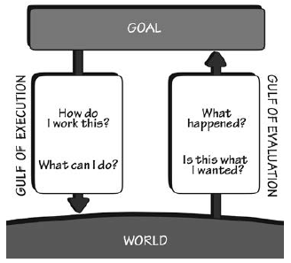

Slide 12
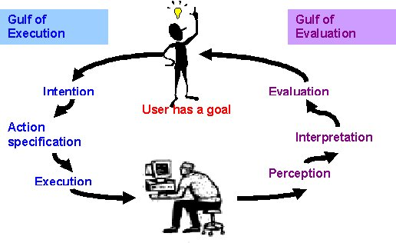

Slide 13
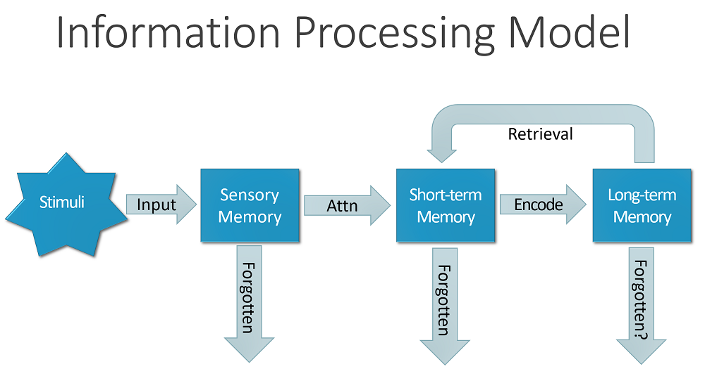
Information processing:
Another classic approach to conceptualizing how the mind works has been to use metaphors and analogies.
One prevalent metaphor from cognitive psychology is the idea that the mind is an information processor.
Information is thought to enter and exit in the mind through a series of ordered processing stages.

Slide 14
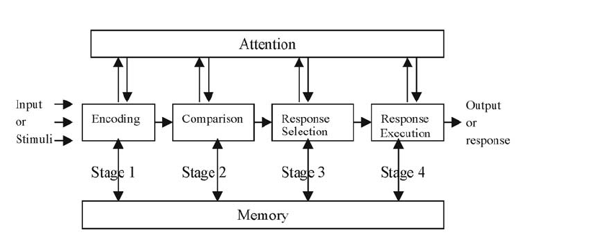
Human Information processing model consists of four stages – Encoding, Comparison , Response Selection, Response Execution.
Within these stages, various processes are assumed to act upon mental representations.

Slide 15
Mental representations are assumed to comprise images, mental models, rules and other forms of knowledge.
The information processing model provides a basis from which to make predictions about human performance.
Hypothesis can be made about how long someone will take to perceive and respond to a stimulus and what occur if a person is overloaded with too much information.
One of the first HCI models to be derived from the information processing theory was the human processor model, which modelled the cognitive processors of a user interacting with the computer.
The model predicts which cognitive processors are involved when a user interacts with a computer, enabling calculations to be made of how long a user will take to carry out various tasks.

Slide 16
External Frameworks:
Distributed cognition : The distributed cognition approach studies the nature of cognitive phenomena across individuals and internal and external representations.
It involves describing a cognitive system , which projects interactions among people and environment there are working in.
A primary objective of distributed cognition approach is to describe these interactions in terms of how information is propagated through different media.
By this it is meant how information is represented and re-represented as it moves across individuals.
These transformations of information are referred to as changes in representation state.

Slide 17
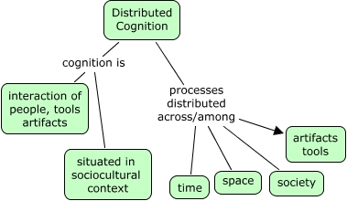
A distributed cognition analysis involves examining:
-the distributed problem solving that takes place.
-the role of verbal and non-verbal behaviour.
-the various coordinating mechanisms that are used.
-the various ways communication takes place as the collaboration activity process.
-How knowledge shared and accessed.

Slide 18
External cognition:
External cognition is concerned with explaining the cognitive processes involved when we interact with different external representations.
A main goal is to explicate the cognitive benefits of using different representations for different cognitive activities and the process involved.
The main ones include
Externalizing to reduce memory load.
Computational offloading.
Annotating and cognitive tracing.

Slide 19
Externalizing to reduce memory load:
Numerous strategies have been developed for transforming knowledge into external representations to reduce memory load.
Ones such strategy is externalizing things we find difficult to remember such as birthdays , appointments and addresses.
Diaries , personal remainders are examples of cognitive artifacts that are commonly used for this purpose.
Externalizing , therefore can help reduce peoples memory burden by
-reminding them to do something.
-reminding them of what to do.
-reminding them of when to do something.

Slide 20
Computational offloading:
Computational offloading occurs when we use a tool or device in conjunction with an external representation to help us carry on a computation.
An example is using a pen and paper to solve math problem.
Annotating and cognitive tracing:
Another way in which we externalized our cognition is by modifying representations to reflect changes that are taking place that we wish to mark.
Annotating involves modifying external representations such as crossing off or underlying items.
Cognitive tracing involves externally manipulating items into different orders or structures.

Slide 21
Embodied interaction:
HCI which group out of collaboration between computer scientist and psychologist initially adopted an information processing perspective but was criticize as failing to account for the ways that people get things done in real situations.
Approaches that focus on practical engagement in real social and physical contexts and the flexible ways were included into interaction.
One of the approach is embodied interaction.
This has been applied quite broadly to : hci , including work that focuses on the emotional quality of interaction with technology , on publicly available actions in physically shared spaces , and on the role of the body in mediating our interaction with technology.
These theories of embodied cognition are more useful in the ways that people experience the world through physical interaction.

Slide 22
